Slide 1
CREDIT CARD FRAUD DETECTION
THE POLICE
-
Cem Akagündüz
Hasan Can Buruk
Göktuğ Övren
Mehmet Akif Tür

Slide 2
EDA ANALYSIS
GENERAL LOGISTICS
  Source of Data
  Introduction
  ML Preprocessing
  ML Analysis
  Conclusion

Slide 3
Source of Data
Data is provided by Mlg-Ulb (Machine Learning Group of Université Libre de Bruxelles) via Kaggle
Data Url is https://www.kaggle.com/mlg-ulb/creditcardfraud
The dataset contains transactions made by credit cards in September 2013 by european cardholders. This dataset presents transactions that occurred in two days, where we have 492 frauds out of 284,807 transactions.

Slide 4
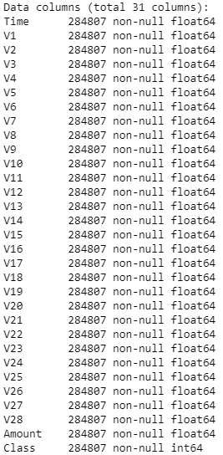
Introduction
The data set has 31 features, 28 of which have been anonymized with PCA and are labeled V1 through V28. The remaining three features are the time and the amount (of the transaction) as well as class,which describes whether transaction was fraudulent or not.
There were no missing values in the data set.

Slide 5
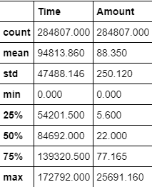
Introduction - 2
Statistical Properties of Time and Amount, Which Are Anonymized Predictors
The distribution of the amount of all transactions is heavily right-skewed. The vast majority of transactions are relatively small and only a tiny fraction of transactions comes even close to the maximum.
Distribution of time is bimodal

Slide 6
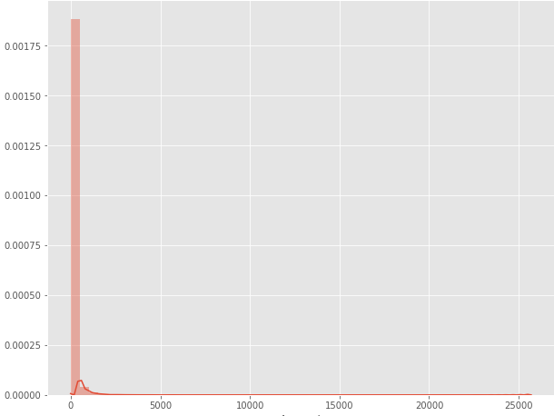
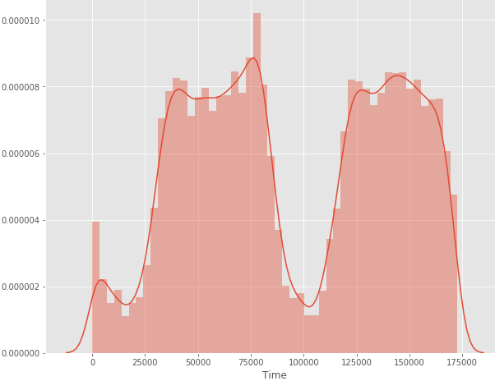
Introduction 2.2
Distribution of Amount
Distribution of Time

Slide 7
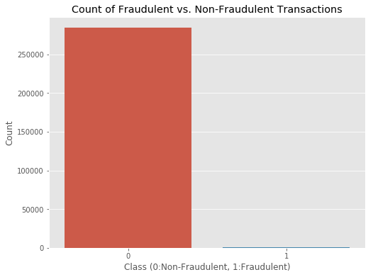
Introduction - 3
Properties of Class, Which is Predicted Feature
It describes whether transaction was fraudulent or not.
In this data, transactions are non-fraudulent. In fact, 99.83% of the transactions in this data set were not fraudulent while only 0.17% were fraudulent.

Slide 8
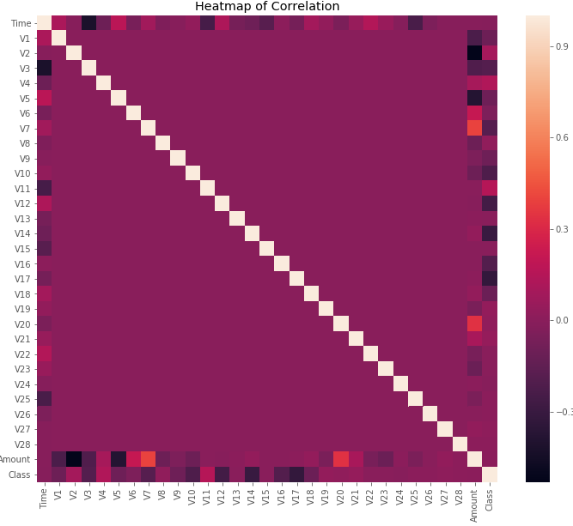
Introduction -4
Heatmap Correlation
Some of our predictors seem to be correlated with the class variable. Nonetheless, there seem to be relatively little significant correlations for such a big number of variables because of anonymized /principal component data and huge class imbalance.

Slide 9
ML Preprocessing -1
Standardization
  We know that the anonymized features have been scaled and seem to be centered around zero, but time and amount features have not.
  This would result in certain machine learning algorithms like Logistic Regression which gives weights to features performs much worse.
  We standardized both the time and amount column.

Slide 10
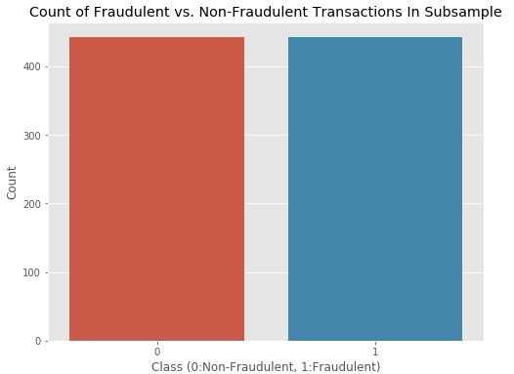
ML Preprocessing-2
Struggling of Imbalanced Data
  To create our balanced training data set, We will take all of the fraudulent transactions in our data set and count them. Then, We will randomly select the same number of non-fraudulent transactions and concatenat the two.
  This process is called random under sampling

Slide 11
ML Preprocessing -3
Outlier Detection & Removal
  We will focus exclusively on features with a correlation of 0.5 or higher with the class variable for outlier removal.
  We reduced our data size from 884 transactions by 259 transactions to 625 transactions.

Slide 12
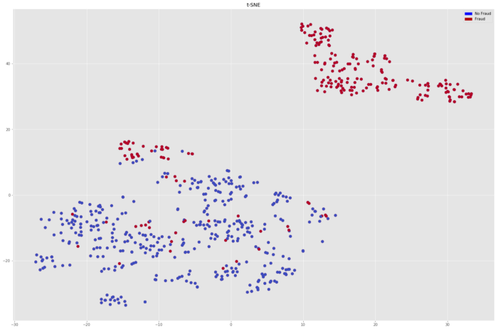
ML Process-1
First, We will use t-SNE Clustering Algorithm to see Whether Our Classes Are Clearly Seperable or Not
As You Can See, We are able to produce 2 classes

Slide 13
ML Process-2
We will use 3 different classification algorithms, which are Logistic Regression CART and Random Forest.
Also, to avoid overfitting, We use the very common resampling technique of k-fold cross-validation.
  It can also be thought as ML Process-3

Slide 14
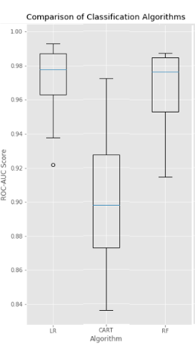
ML Processing 2.2
LR: 0.969945 (0.022522)
CART: 0.899554 (0.039180)
RF: 0.966171 (0.022672)
Best Performing Algorithm is Logistic Regression with Higher Mean and Smaller Variance but Rf also almost show same performance.

Slide 15
Conclusion
In previous slide, we showed two algorithms, which are LR and RF showed qualified performance for the task, but we should focus on not only the achieving the highest accuracy but also to create business value.
Therefore, choosing Random Forest might be a reasonable approach in order to achieve a higher degree of comprehensiveness while only slightly decreasing performance.

Slide 16
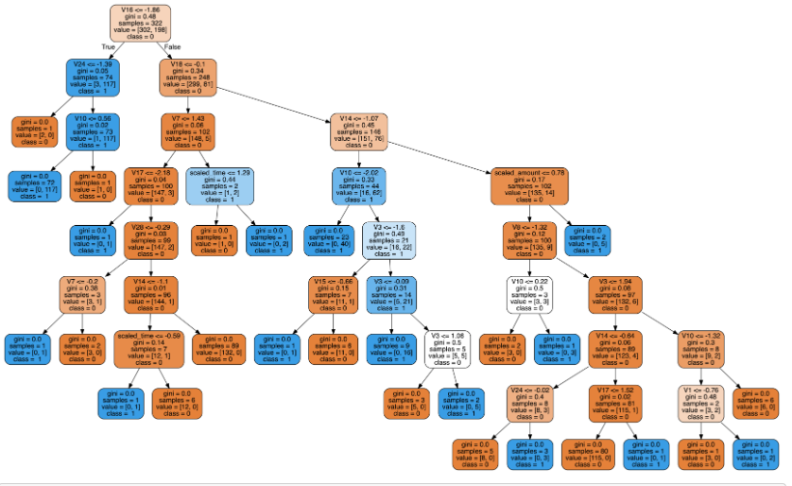
Conclusion – cont’d

